Slide 1
From Conway to LangGraph: Agent Systems for Physicists
From Von Neumann's Dreams to Wolfram's Complexity

Slide 2
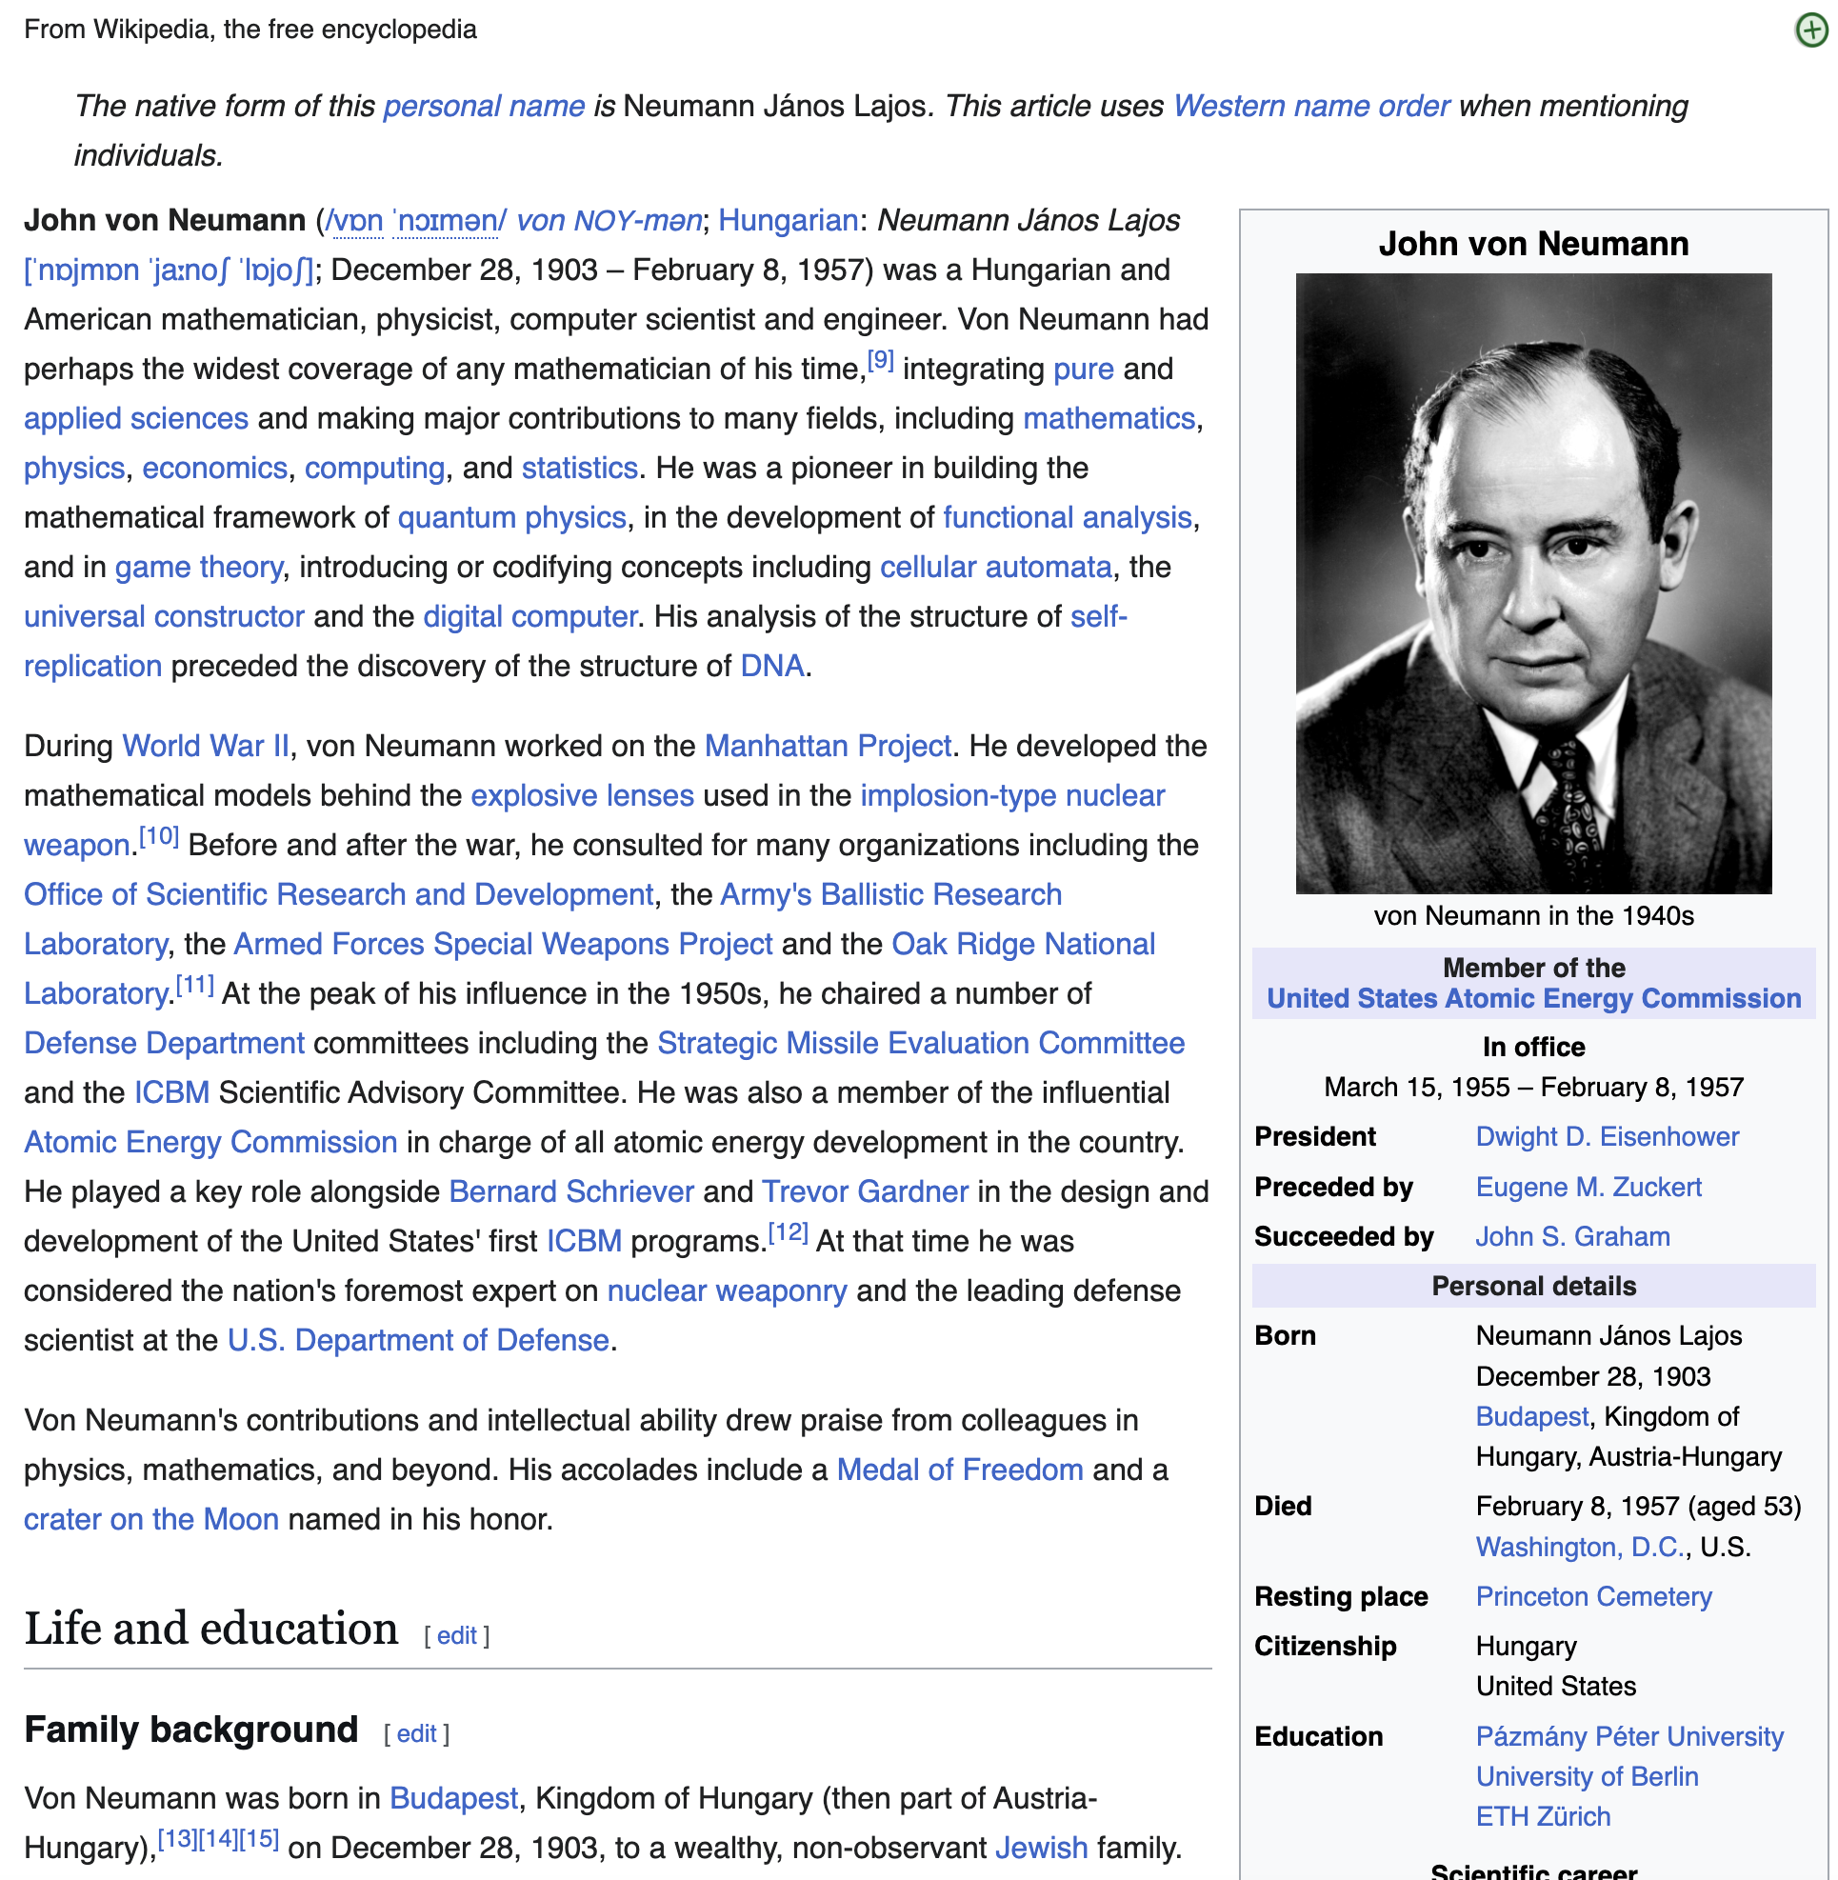
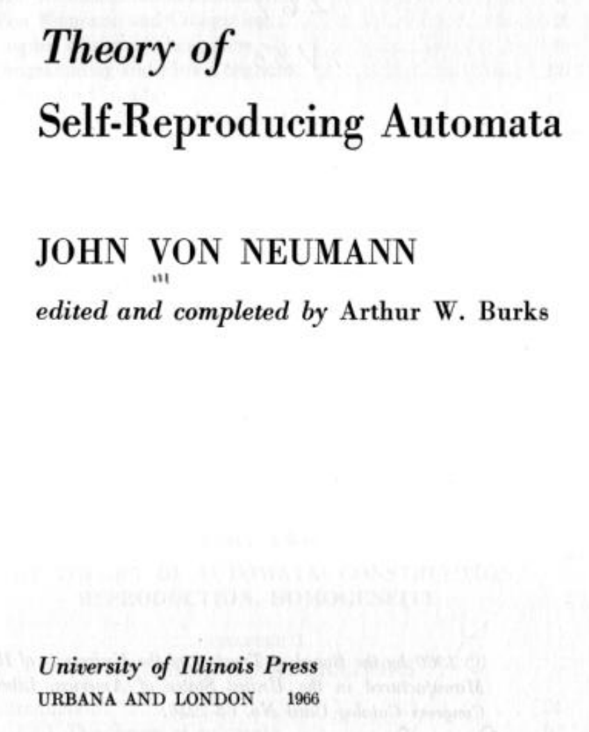
The dawn of computing in physics (1940s-1950s)
Von Neumann (1940s):
Self-replicating automata
Motivation: understanding the logic of life
Problem: models too complex (29 states!)

Slide 3
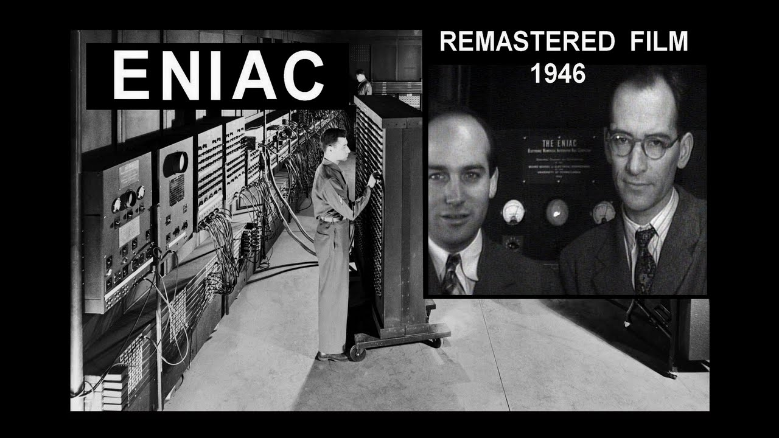

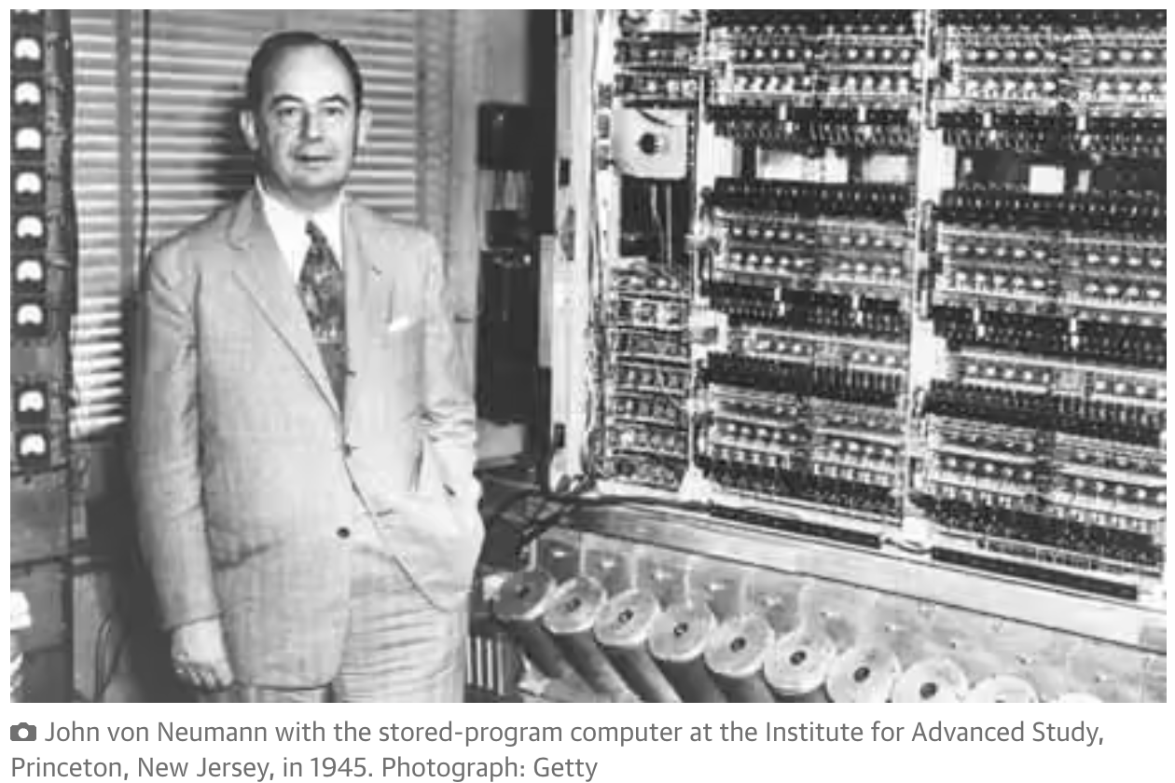
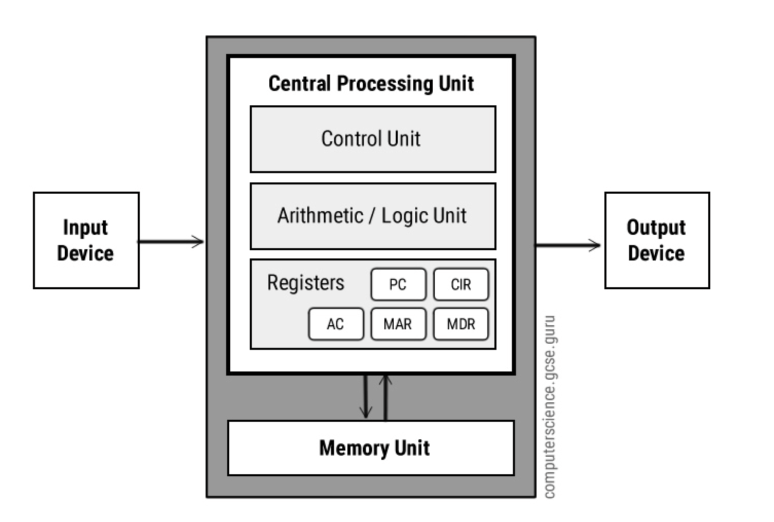
ENIAC (Electronic Numerical Integrator and Computer)
was designed and built by:
J. Presper Eckert
John W. Mauchly
University of Pennsylvania Construction: 1943–1945 Public unveiling: February 1946
It was originally funded by the U.S. Army for ballistic calculations.
The von Neumann architecture
The MANIAC……

Slide 4

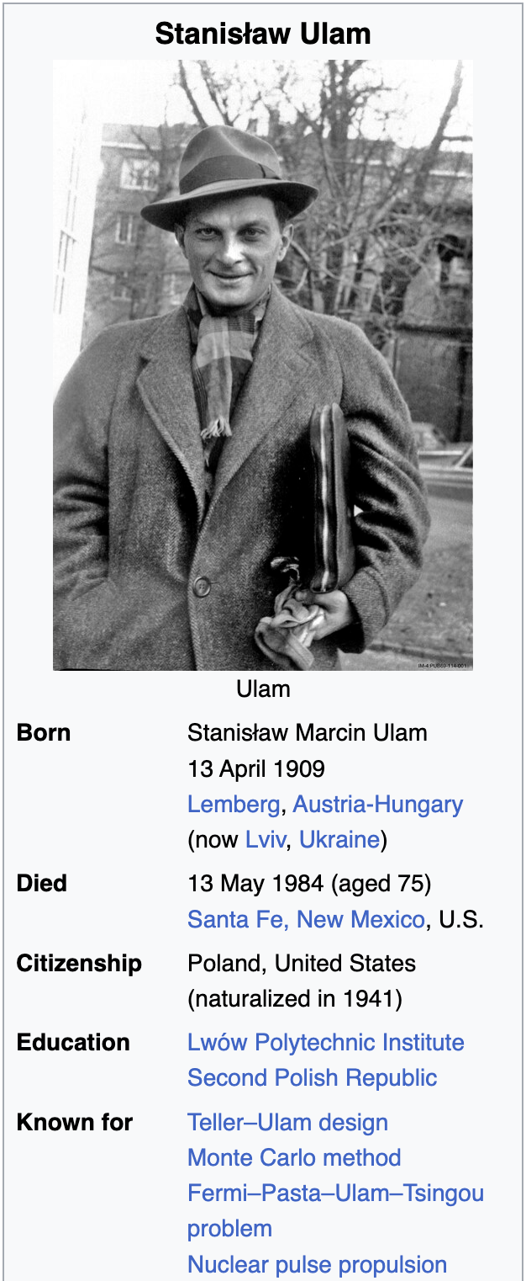
The dawn of computing in physics (1940s-1950s)
Stanislaw Ulam (1940s):
Collaboration at Manhattan Project → Los Alamos
The discrete grid intuition
Proposal: discrete systems on regular lattice

Slide 5
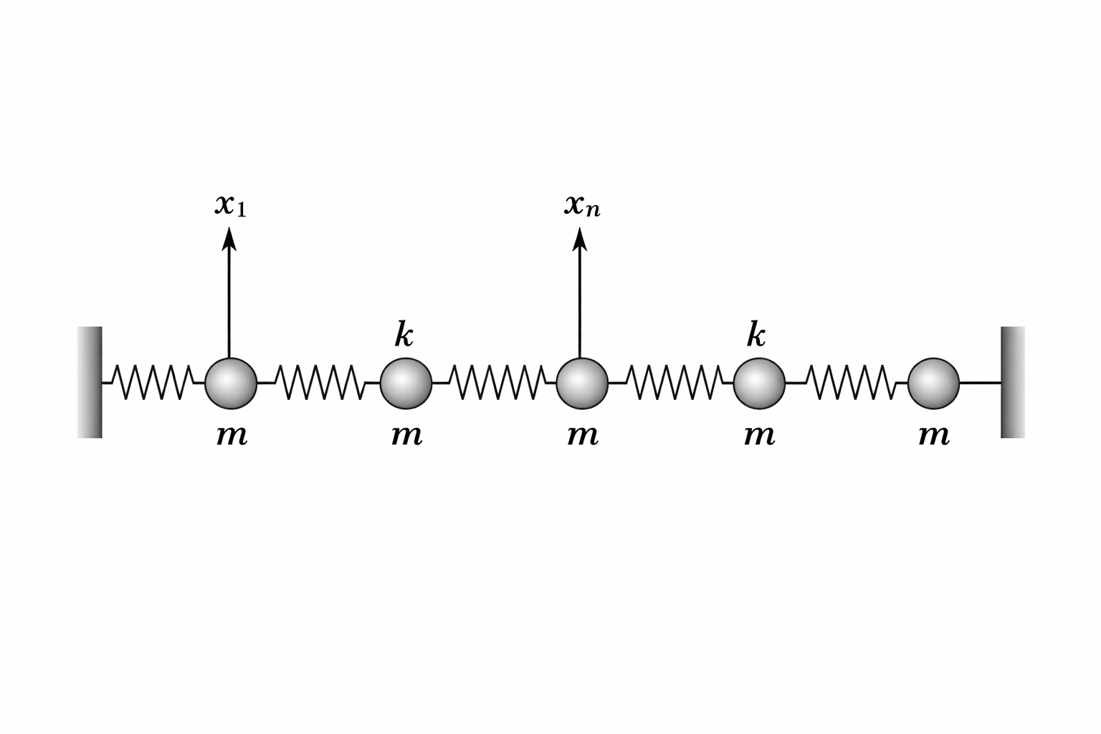
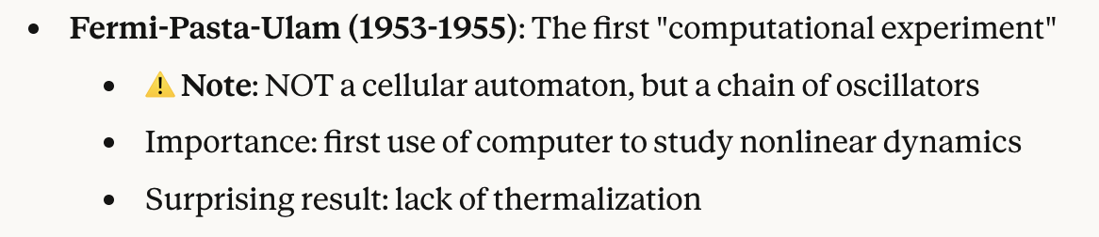
Fermi-Pasta-Ulam (1953-1955):
The first “computational experiment"

Slide 6

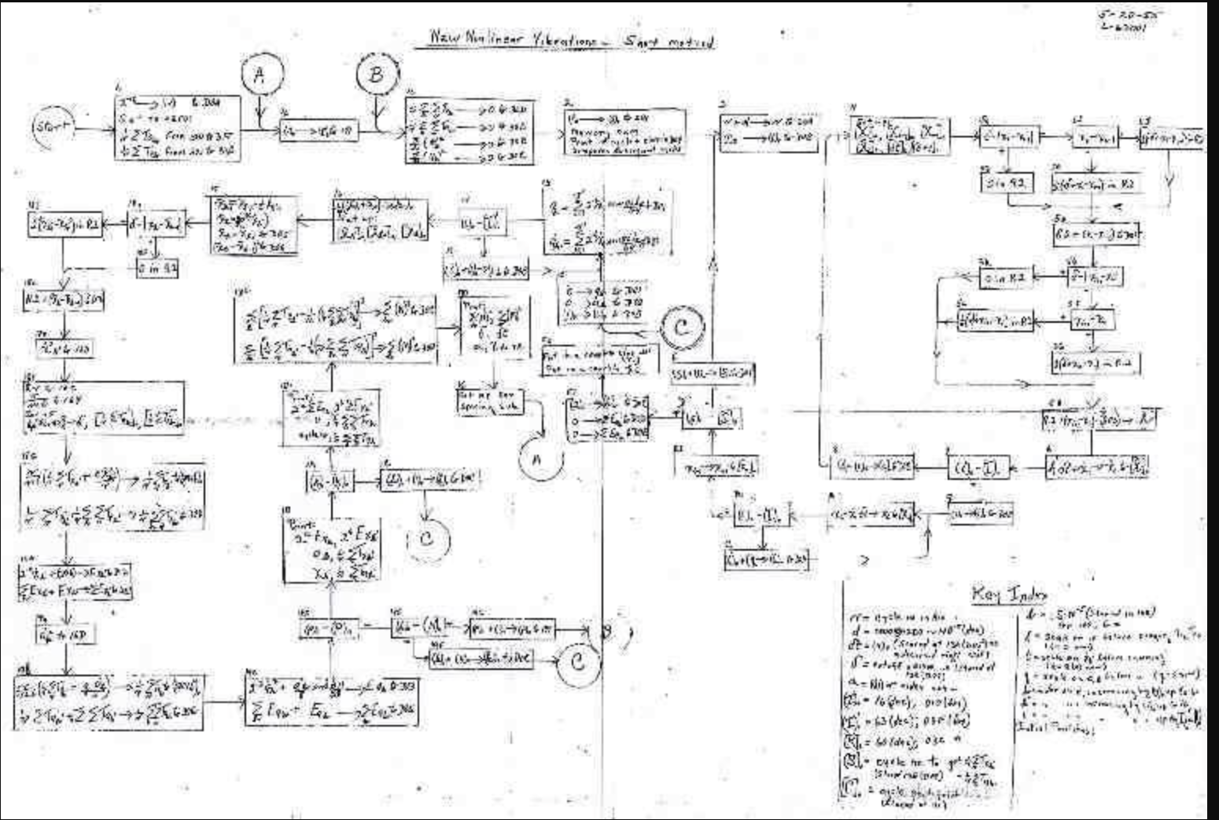
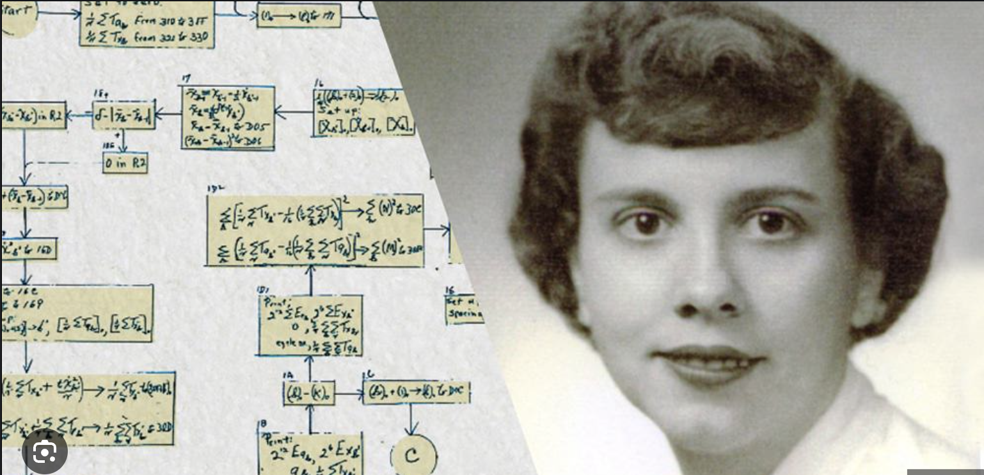
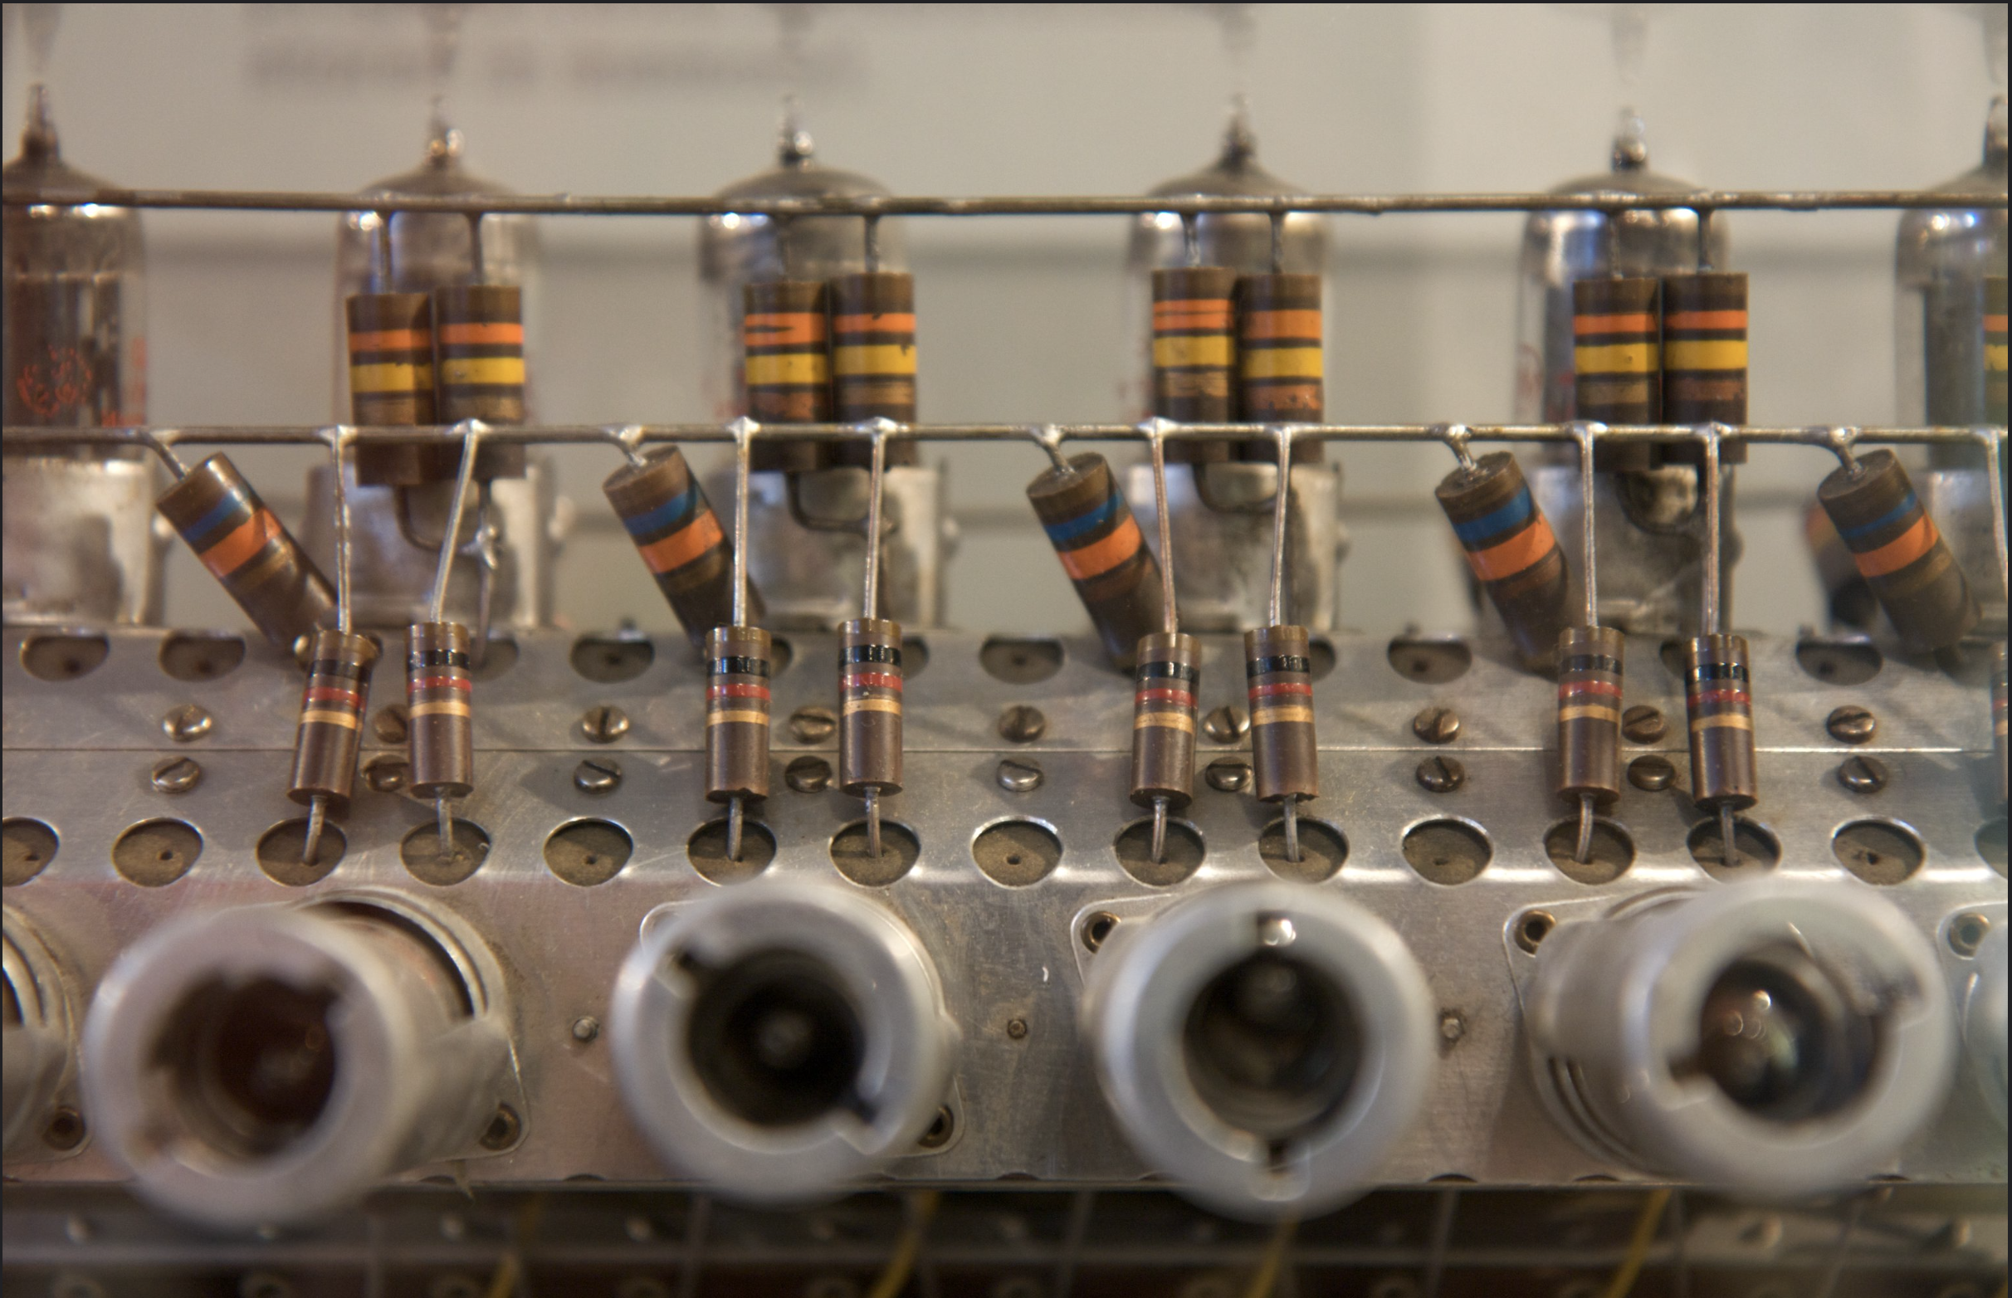
Today The TFPU Model (1953-1955):
Mary Tsingou
MANIAC tubes and circuits

Slide 7

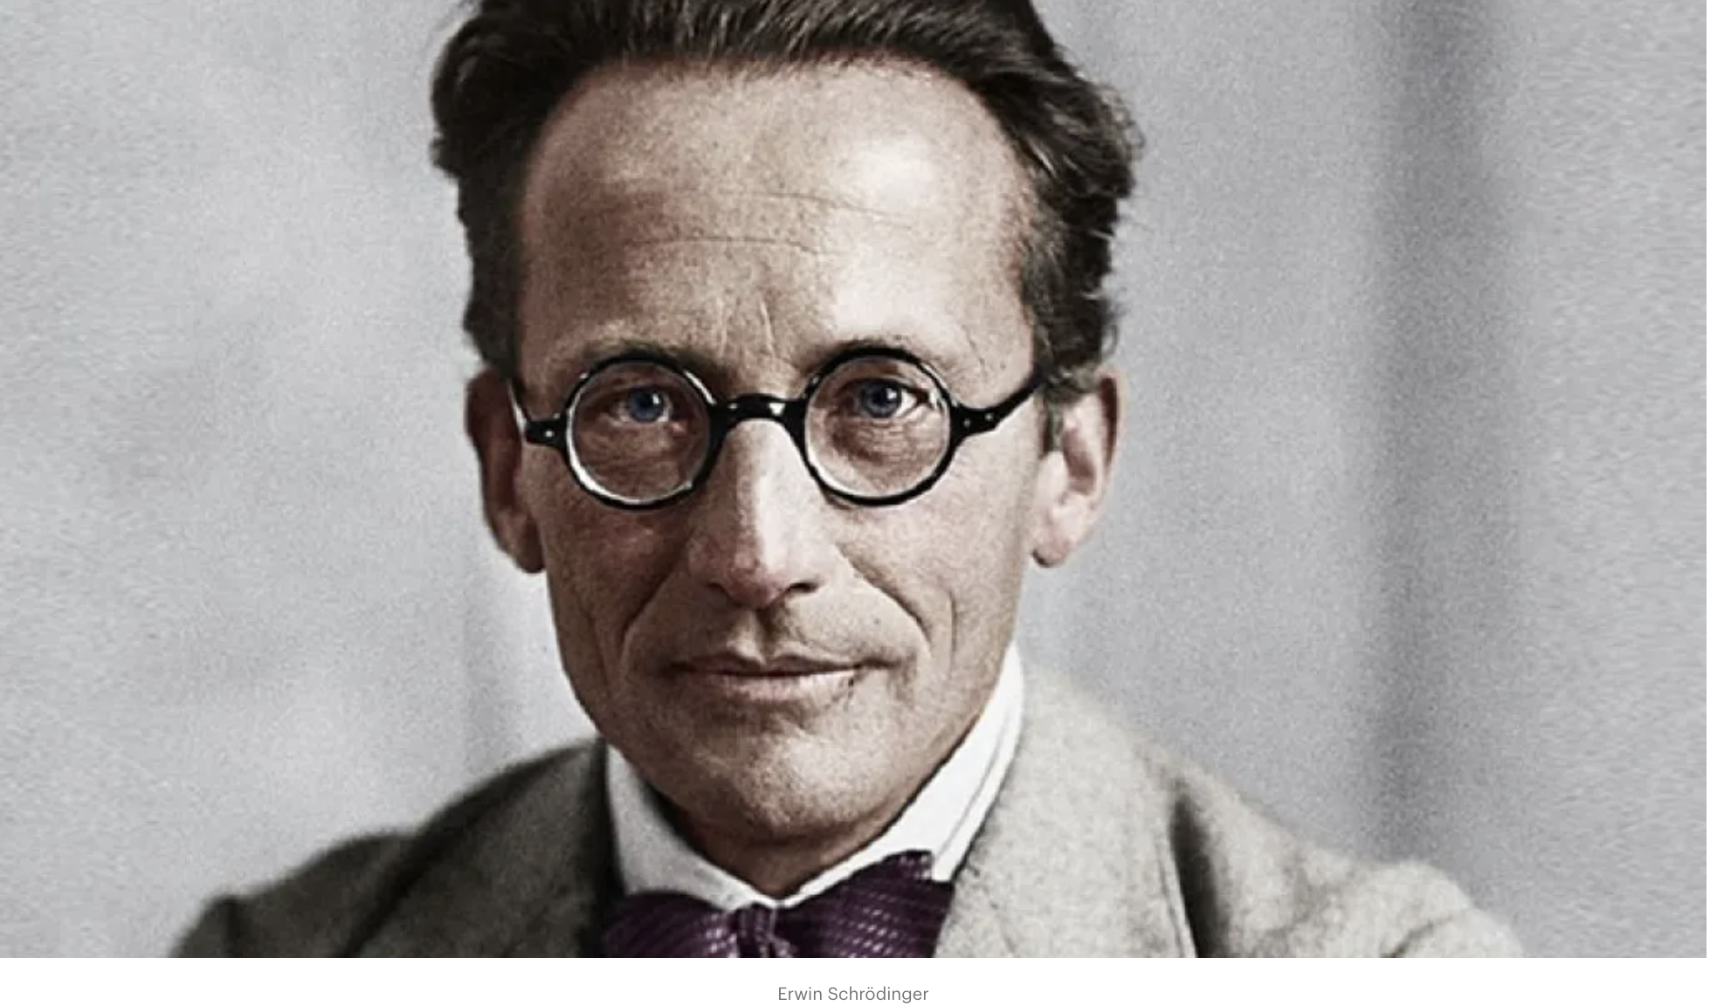
To finish the Story…………and CS and Genomics are born

Slide 8
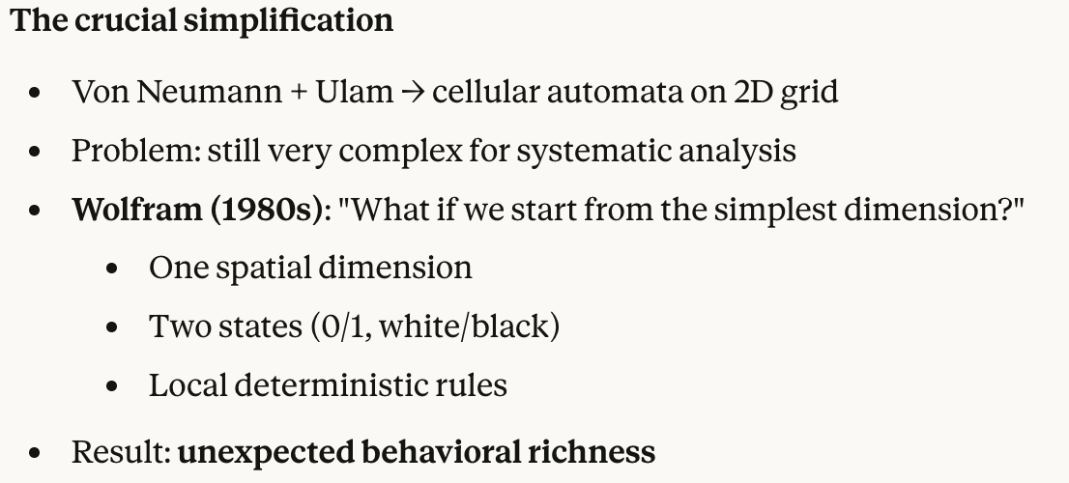
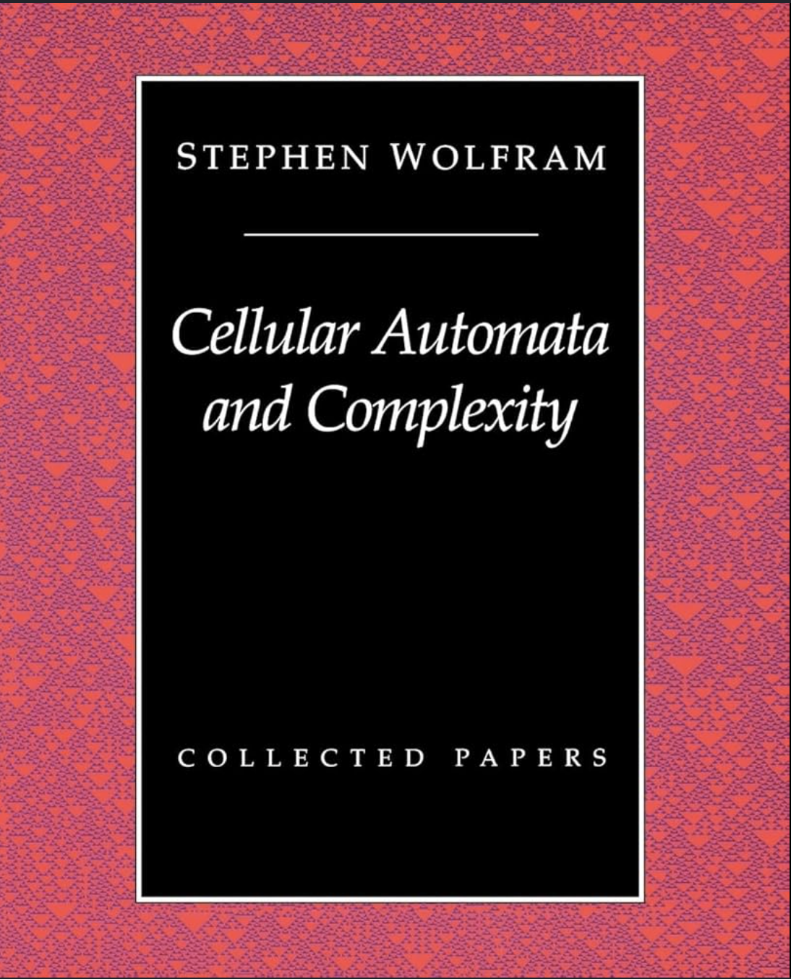
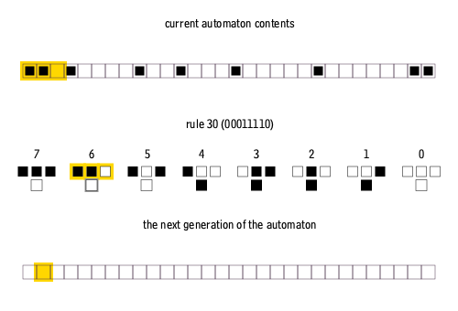
From complexity to simplicity

Slide 9
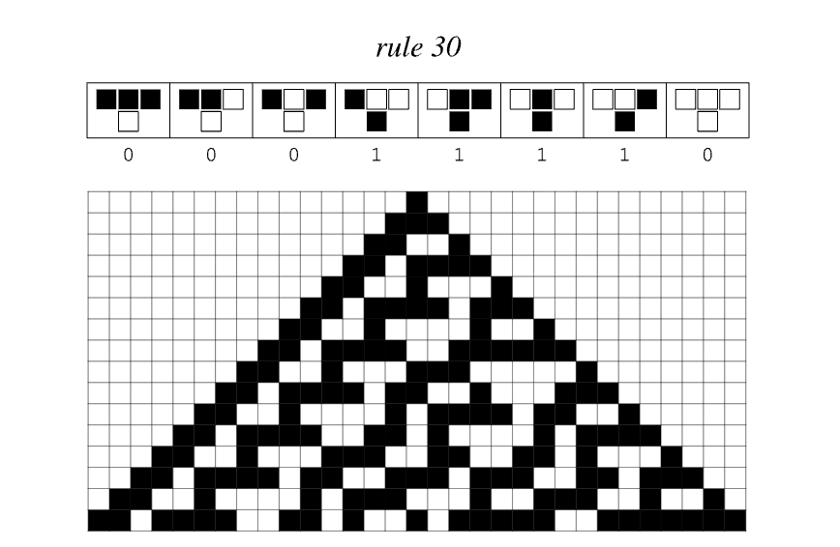
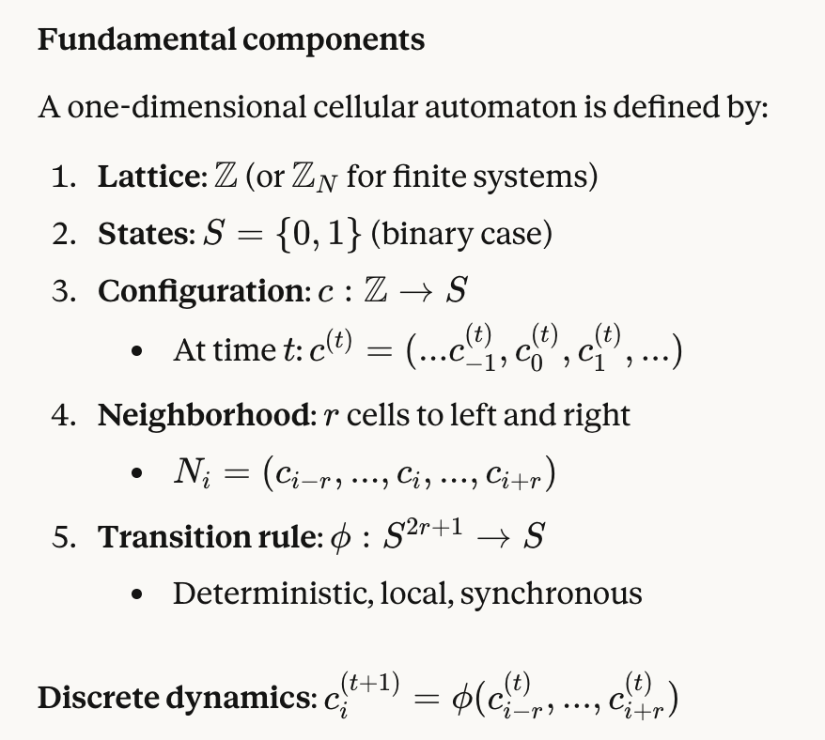
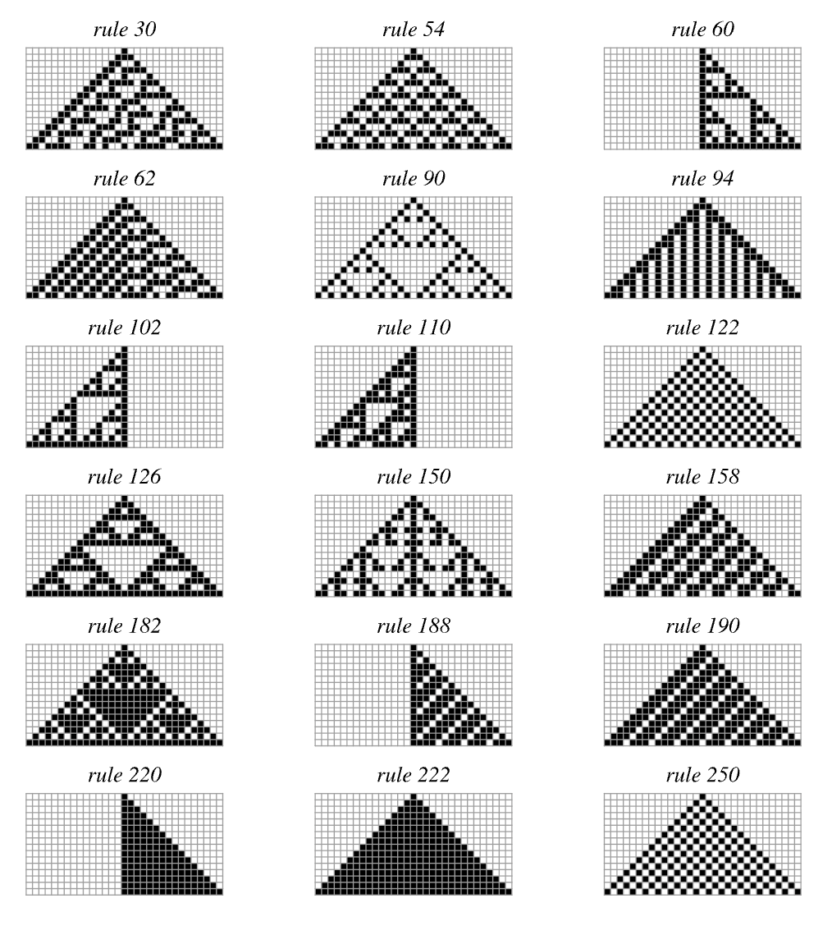
Rigorous definition of 1D CA

Slide 10
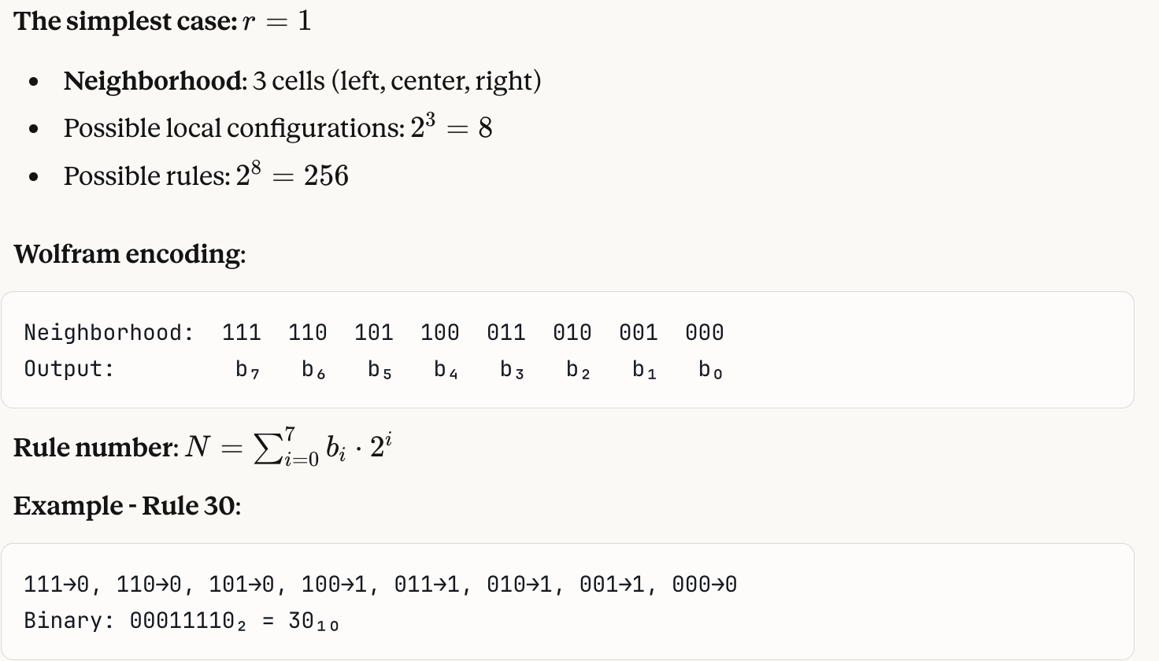
Elementary Cellular Automata (ECA)

Slide 11
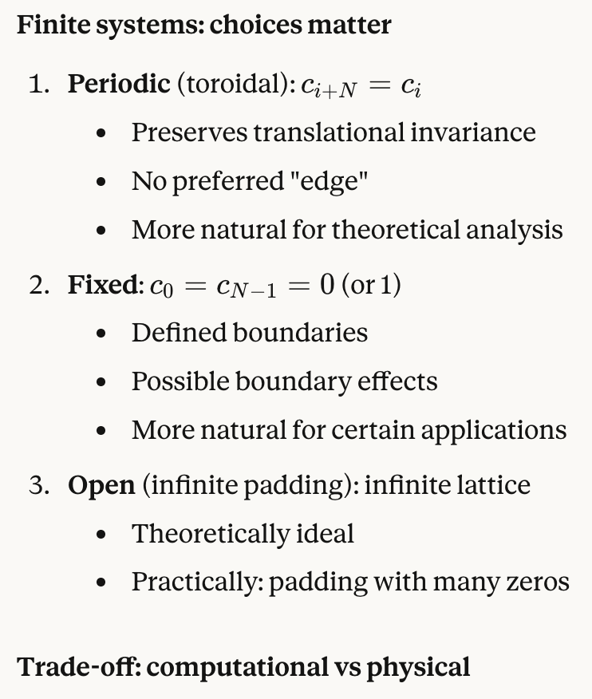
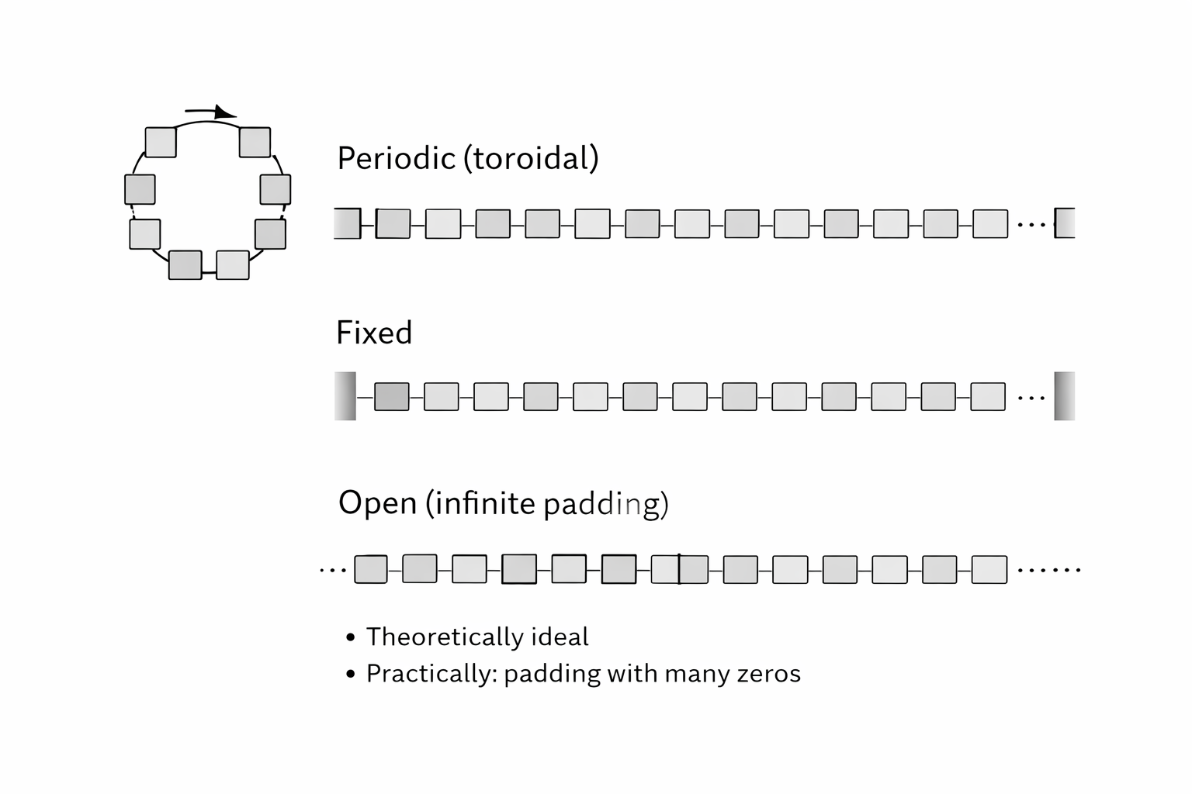
Boundary conditions

Slide 12
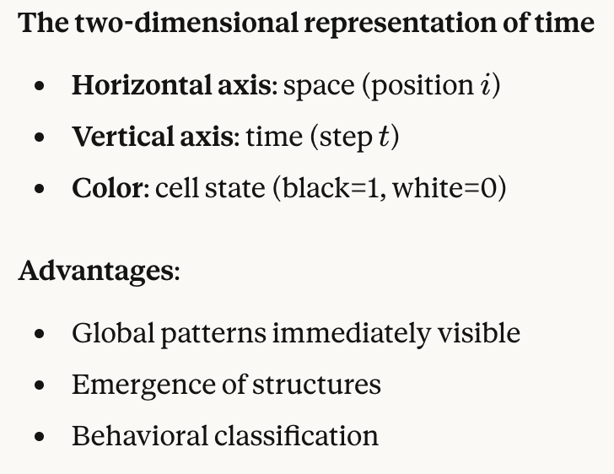
Space-time diagrams

Slide 13
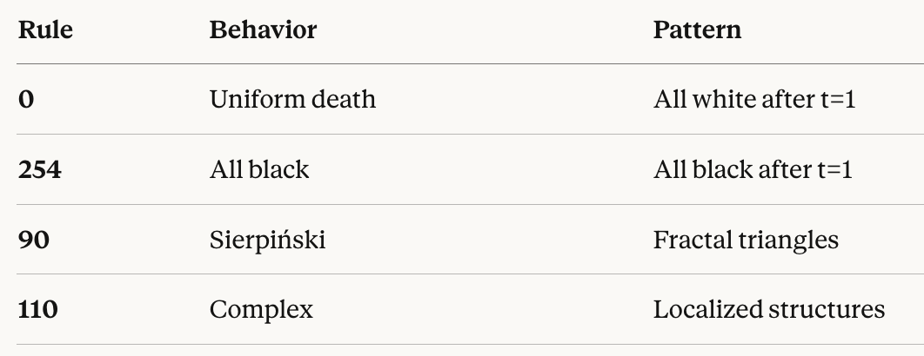
Iconic examples - First look

Slide 14
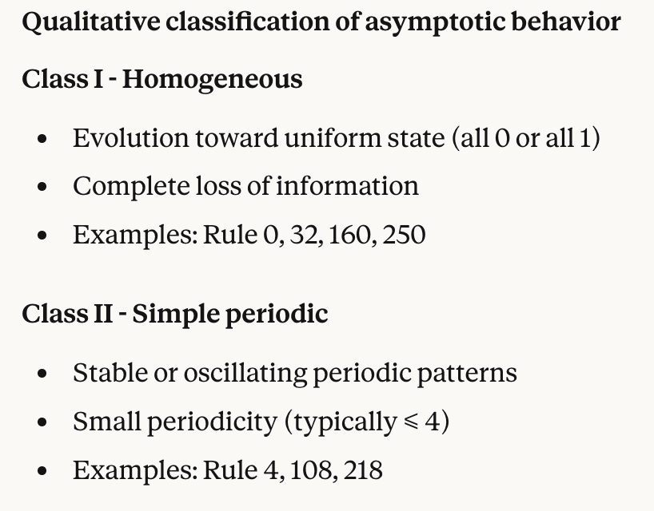
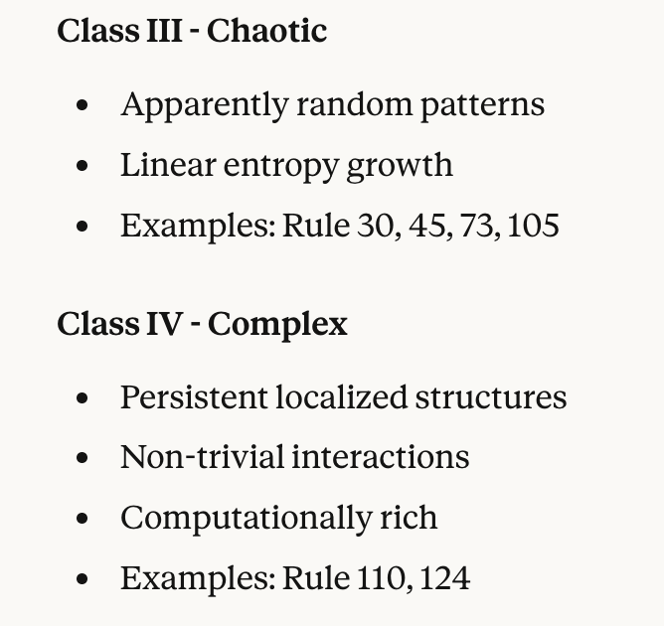
Wolfram's four classes (1984)

Slide 15
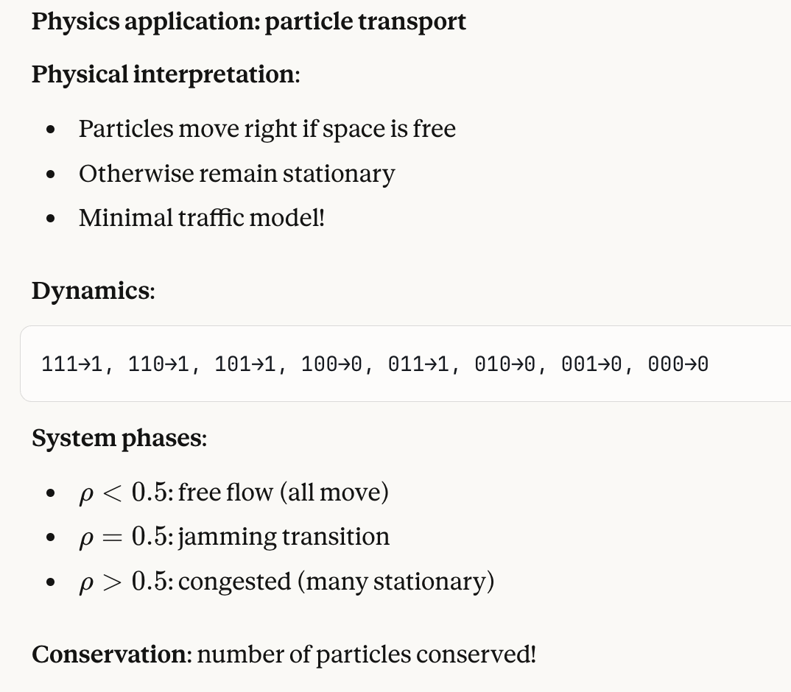
Rule 184 - Traffic flow model (class 2)

Slide 16
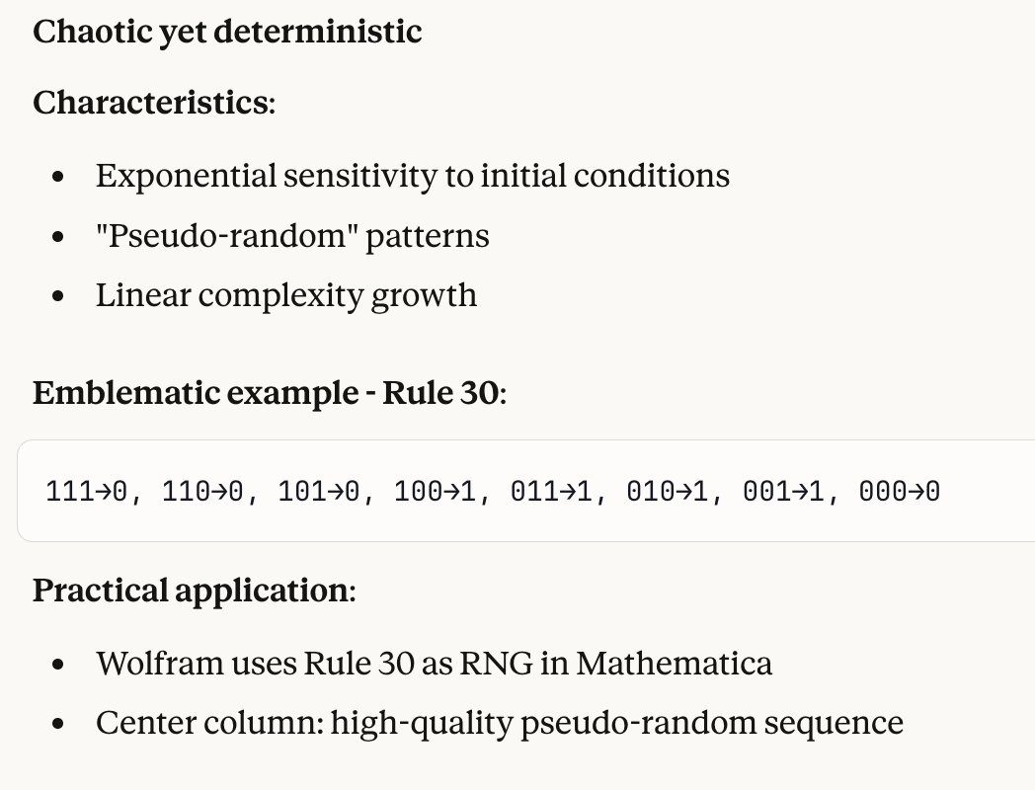
Class III - Deterministic chaos

Slide 17
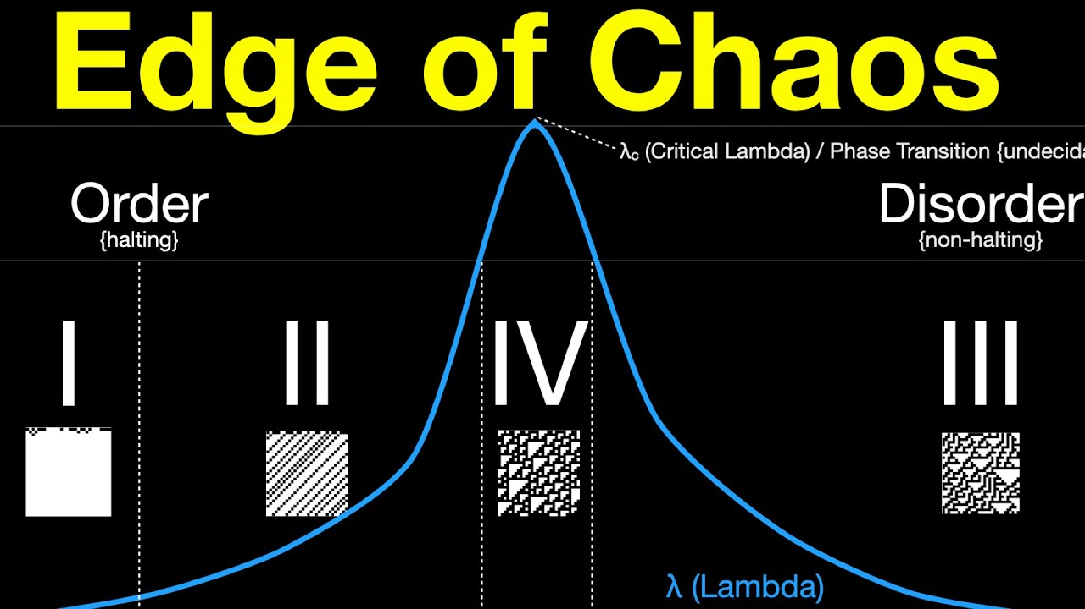
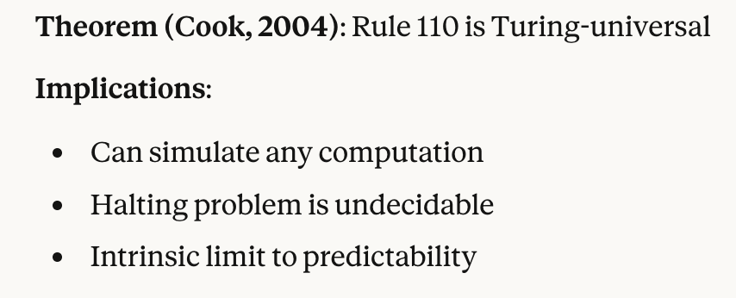
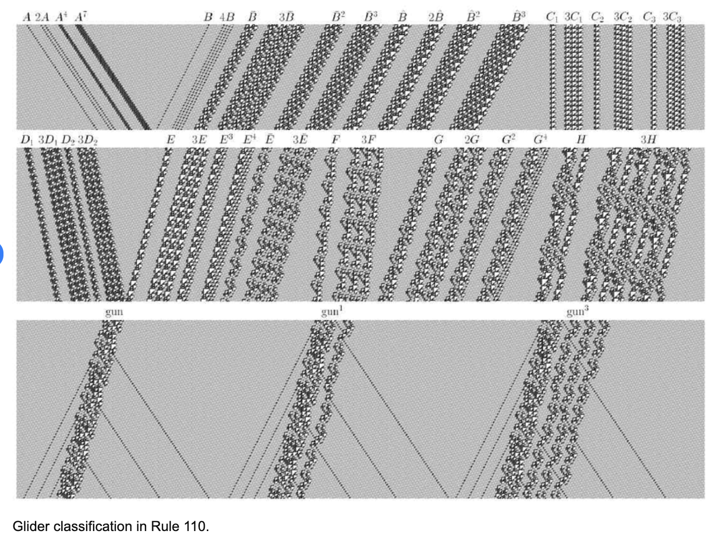
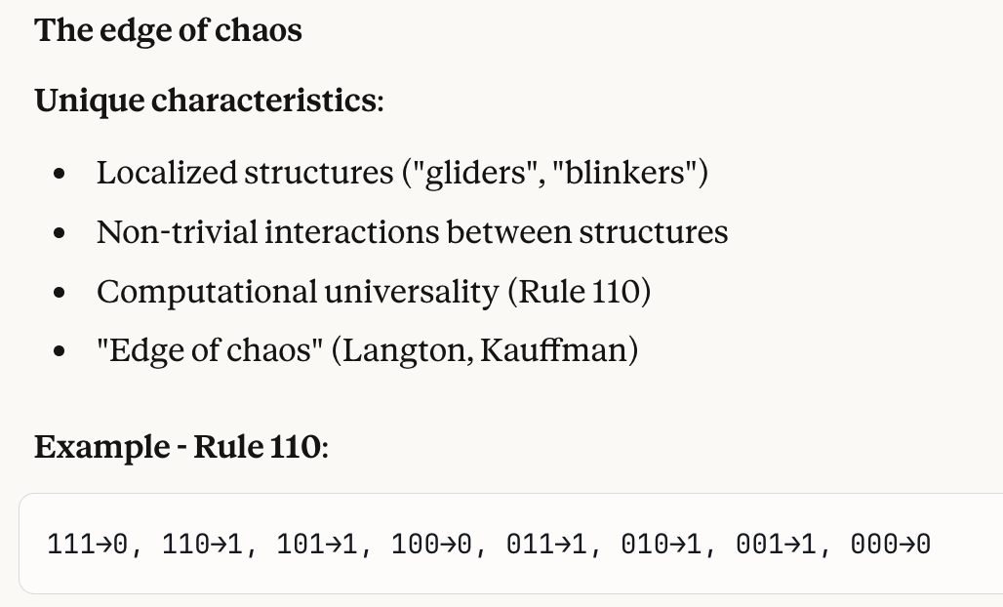
Class IV - Computational complexity

Slide 18
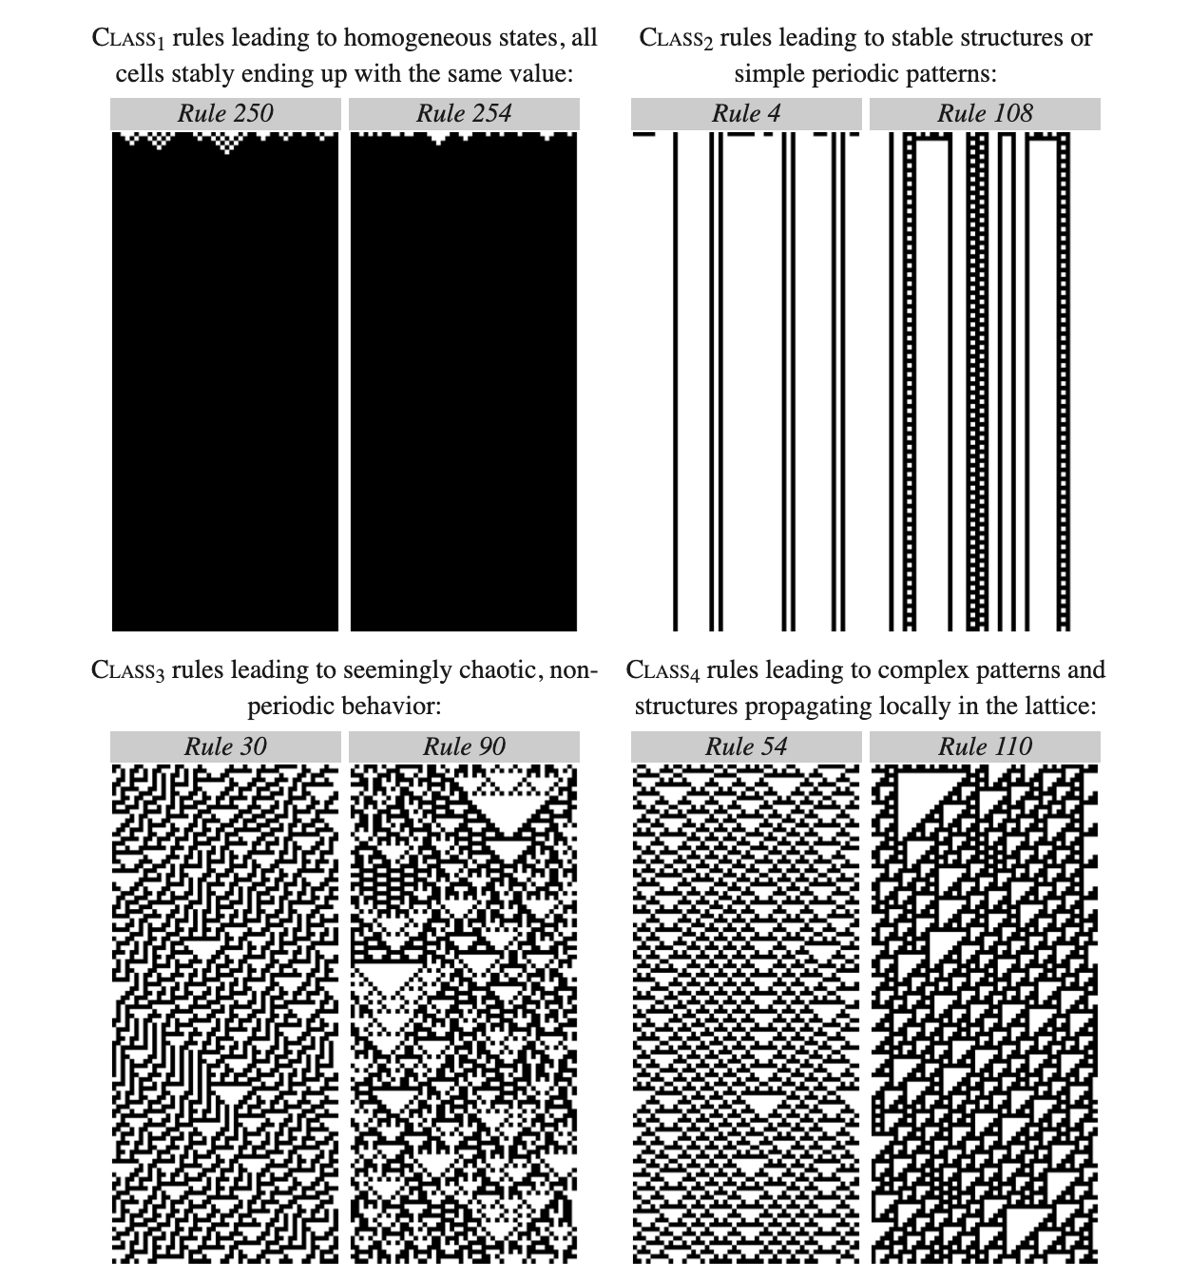

Slide 19


